Slide 1


Discrete Molecular Dynamics Potential Function Based on Bayesian Statistics
CPSC 8420 Final Project
Gangtong Huang
Zhenzhen Zhang

Slide 2
Background
Protein Structure
Molecular Dynamics Simulations

Slide 3
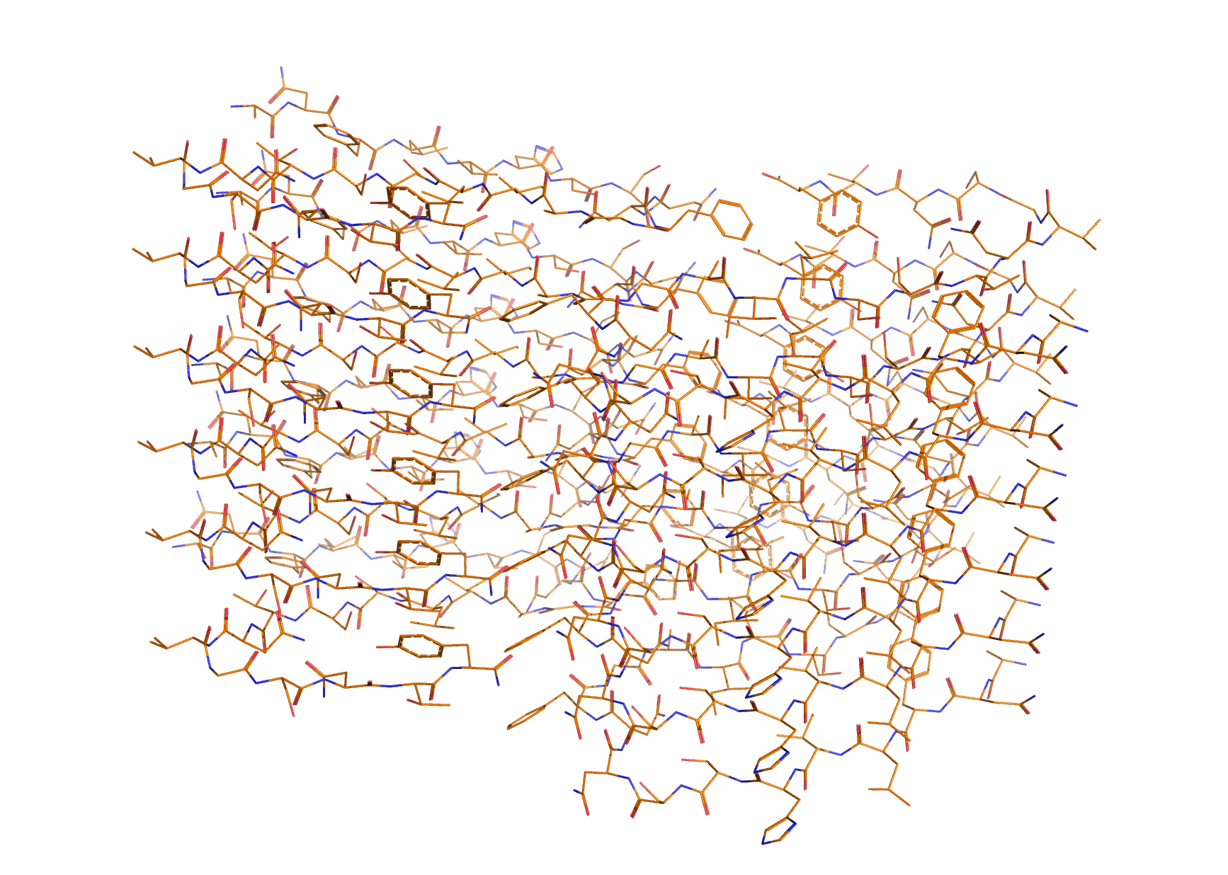
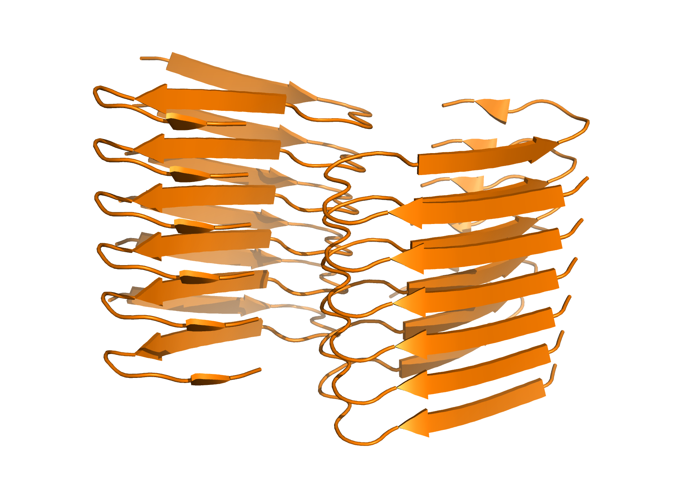
Protein Structure

Slide 4
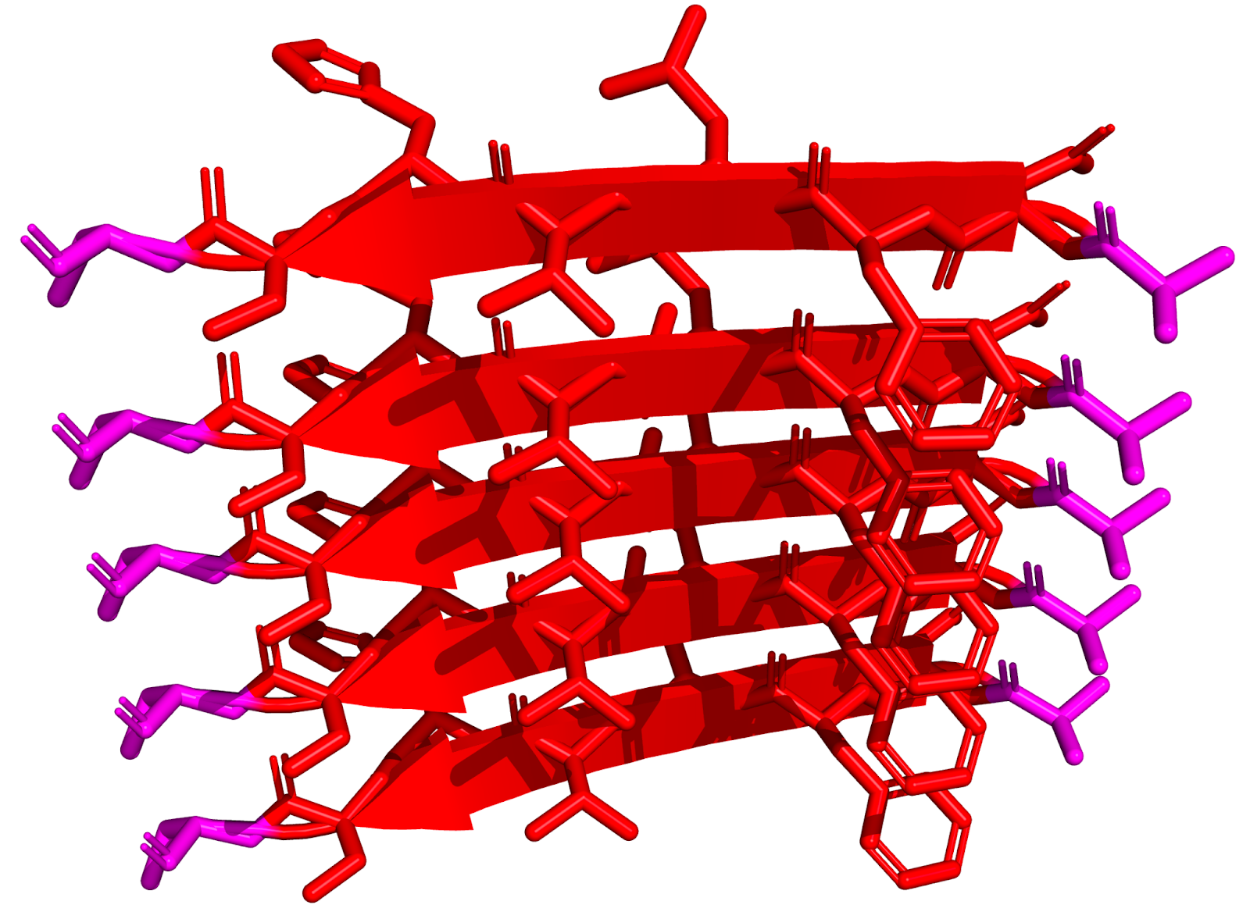
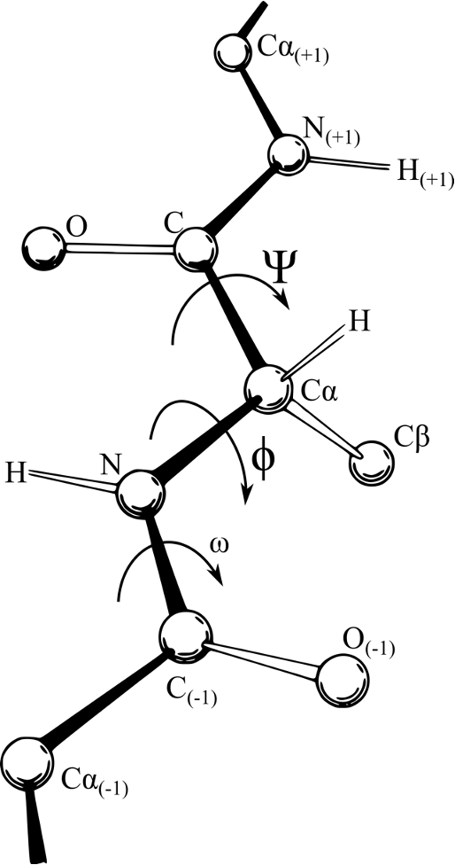
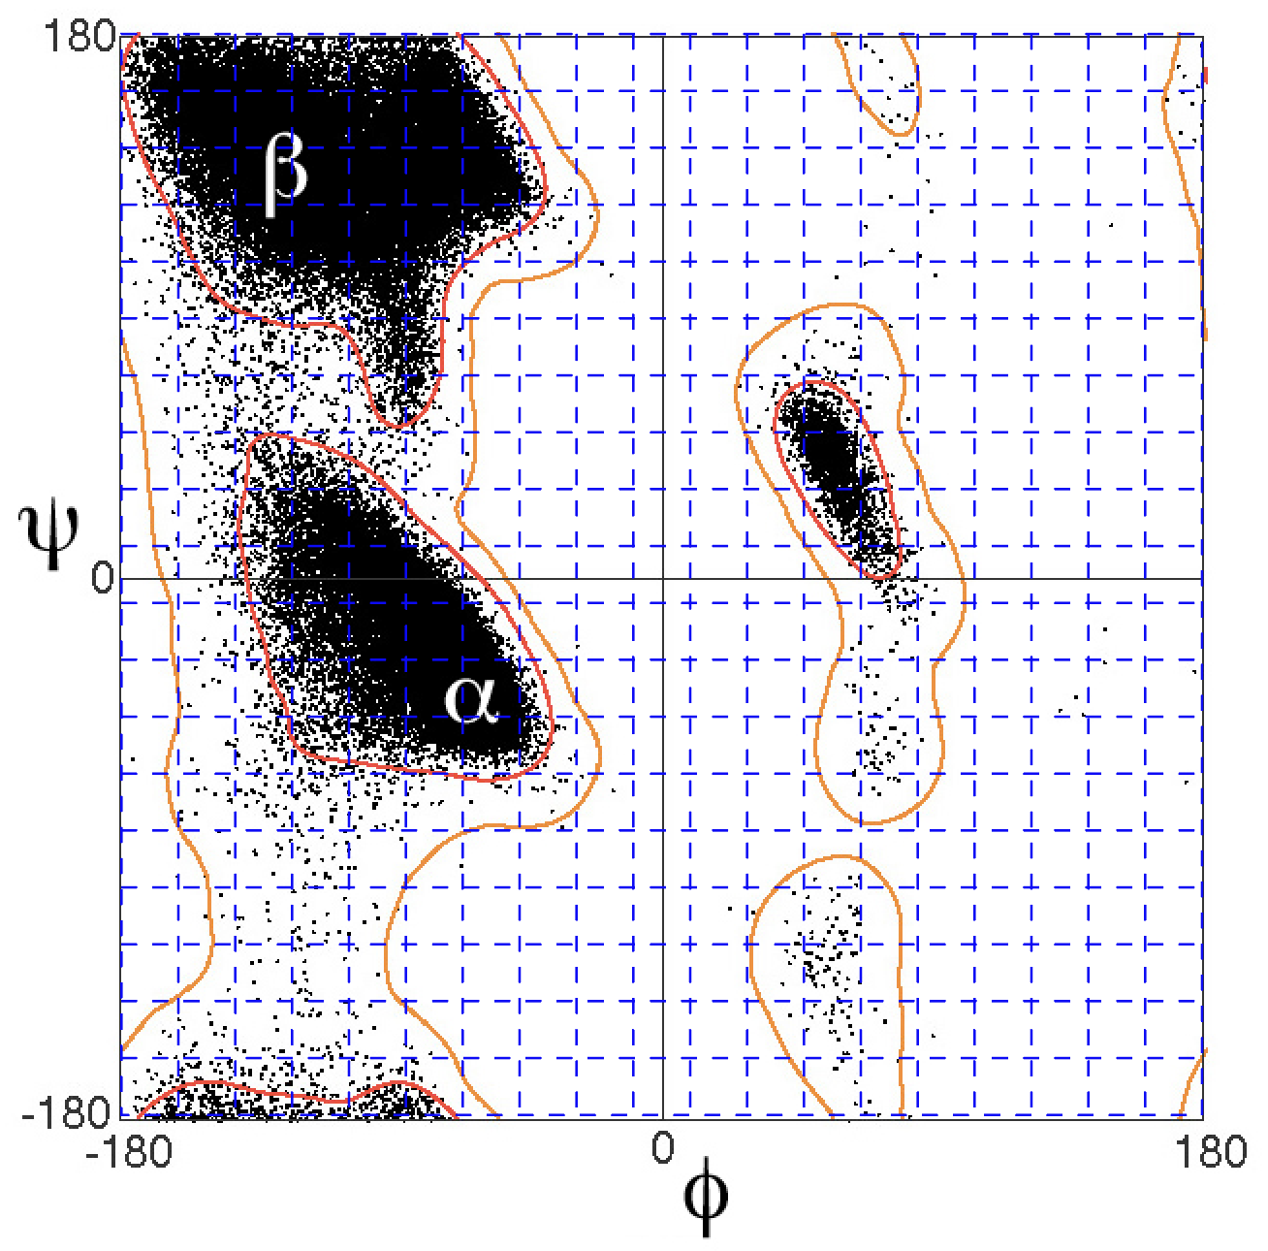
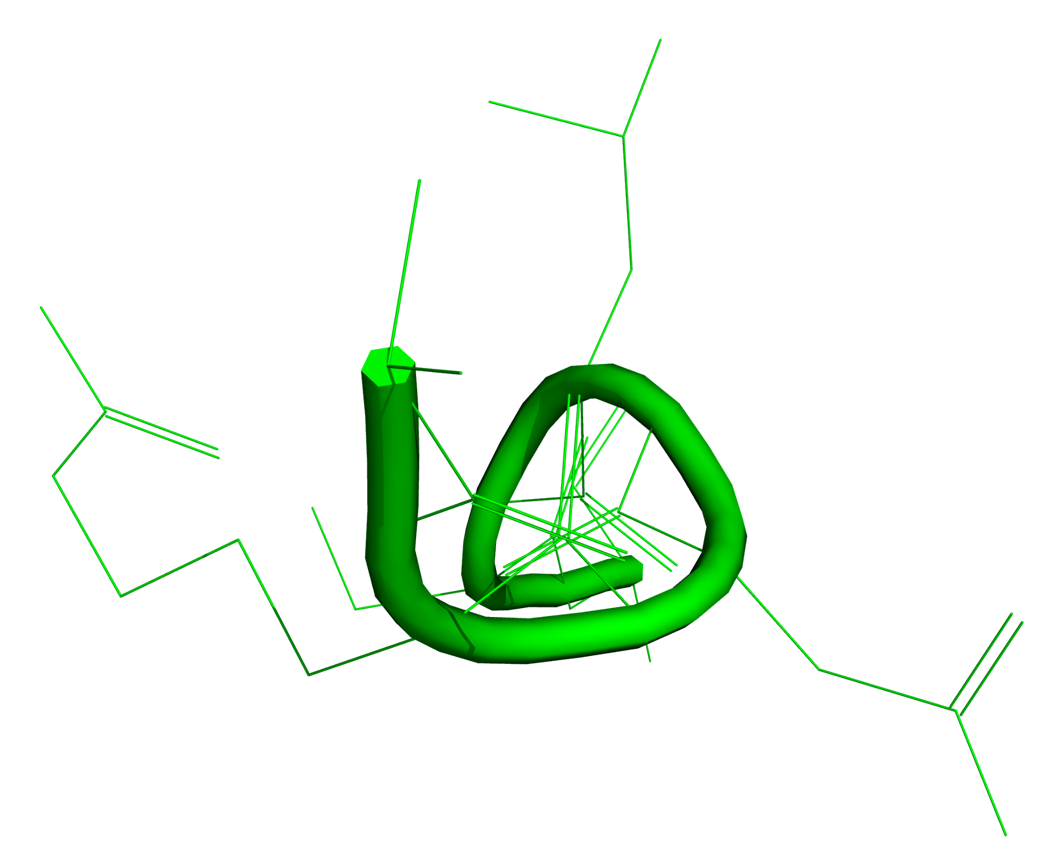
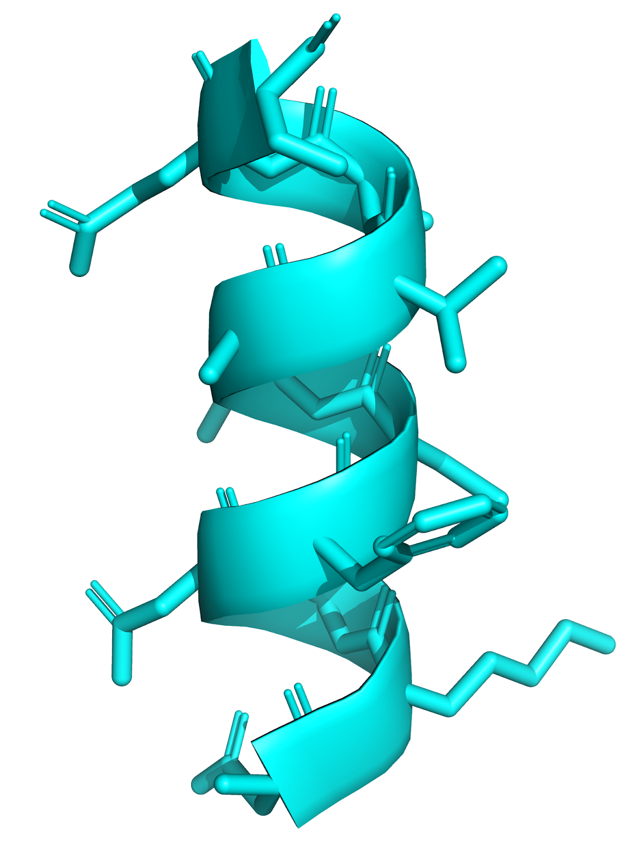
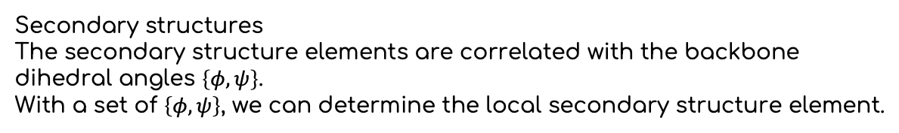
Protein Structure
Secondary structures
The secondary structure elements are correlated with the backbone dihedral angles $\left\{φ, ψ\right\}$.
With a set of $\left\{φ, ψ\right\}$, we can determine the local secondary structure element.
i+1
PPII
PPII
i
i-1
Notes:
Protein backbone dihedral angle
A backbone dihedral angle of a protein is the internal angles {φ, ψ} of polypeptide backbone at the C_{α} (point) which two adjacent amino acid residues (planes) meet.
Secondary structure is the local 3D structure of a protein region.
Three major protein secondary structure are: α-helix, β-sheets, poly-proline II helix (PPII).
、

Slide 5
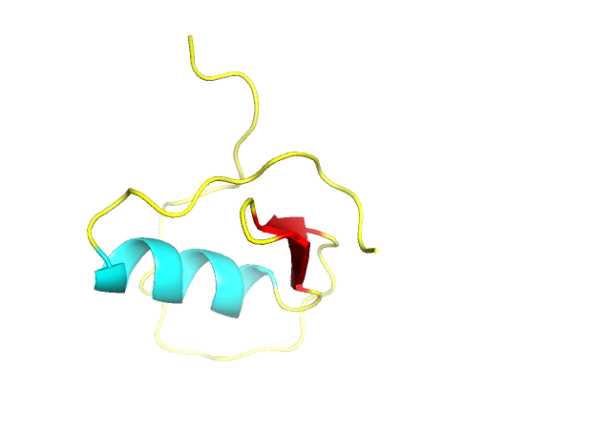
Molecular Dynamic Simulations

Slide 6
Methods
Data Set preparation
Bayesian statistics
Solution of large linear equation set with SVD
Correction and smoothing

Slide 7
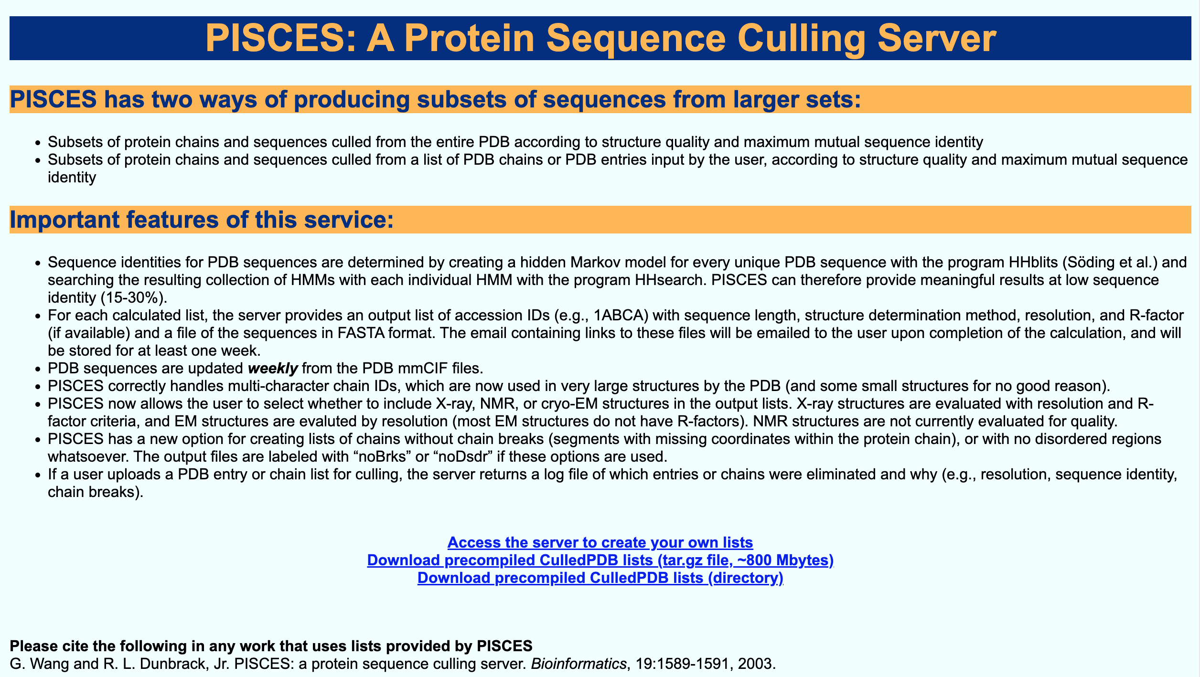
Data Set Preparation
Data website: http://dunbrack.fccc.edu/pisces/

Slide 8
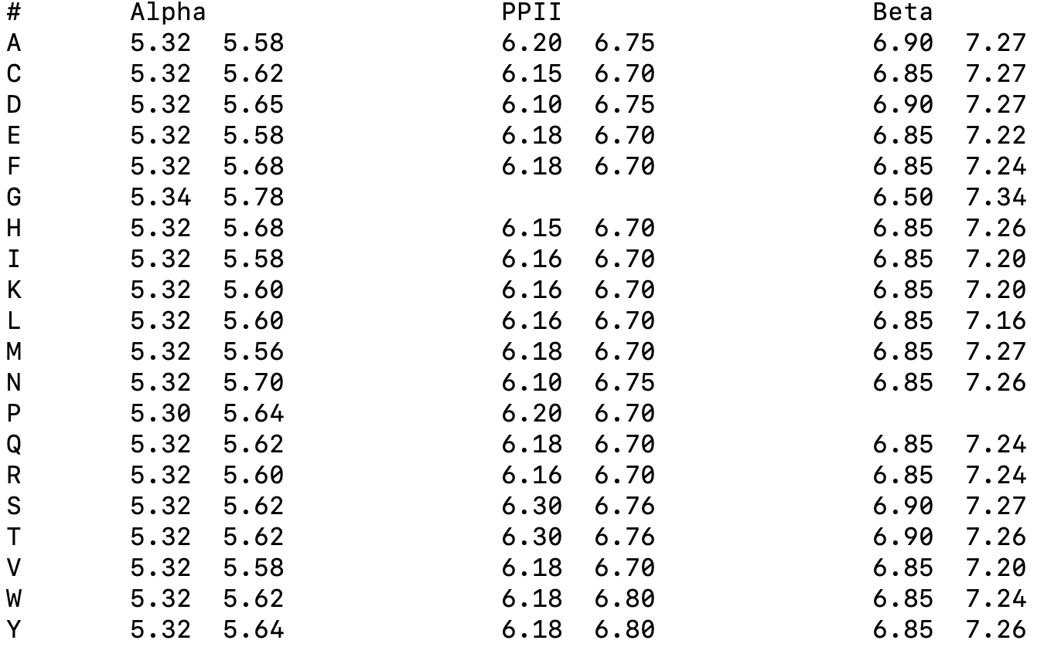
Bayesian statistics
States distance cutoff ( D_{min}, D_{max} )
i+1
i
20 Amino Acids
i-1
Distances between CA (Å)

Slide 9
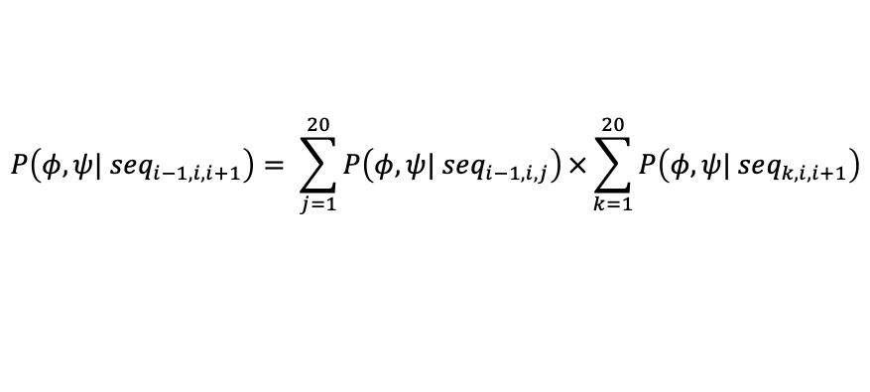
Bayesian statistics
For a certain sequence of i-1, i, i+1, even if no such sequences exist in the data set, we define:
$$P\left(φ, ψ| seq_{i−1, i, i+1}\right)=P\left(φ, ψ| seq_{i−1, i}\right)×P\left(φ, ψ| seq_{i, i+1}\right)$$
$$P\left(φ, ψ| seq_{i−1, i, i+1}\right)= \sum_{j=1}^{20}{P\left(φ, ψ| seq_{i−1, i, j}\right)}×\sum_{k=1}^{20}{P\left(φ, ψ| seq_{k, i, i+1}\right)}$$

Slide 10
Solution of large linear equation set with SVD
Bayesian statistics to overdetermined linear equation set
$$P\left(φ, ψ| seq_{i−1, i, i+1}\right)=P\left(φ, ψ| seq_{i−1, i}\right)×P\left(φ, ψ| seq_{i, i+1}\right)$$
By taking the logs of each side of above equations:
$$\ln\left(P\left(φ, ψ| seq_{i−1, i, i+1}\right)\right)=\ln\left(P\left(φ, ψ| seq_{i−1, i}\right)\right)+\ln\left(P\left(φ, ψ| seq_{i, i+1}\right)\right)$$
The problem will turn to solve the resulting linear equations by SVD.

Slide 11

Solution of large linear equation set with SVD
Create matrix and vectors for SVD
For each amino acid in the center, we have
$$AX=B$$
M = $20 × 20 ×$#_of_possible_secondary_structures ( 2 or 3 )
i-1
i+1
N = $20 × 2 ×$#_of_possible_secondary_structures ( 2 or 3 )
i+1 or i-1
Dimension of A: M x N (only 0 and 1)
Dimension of B: M x 1
Dimension of X: N x 1

Slide 12
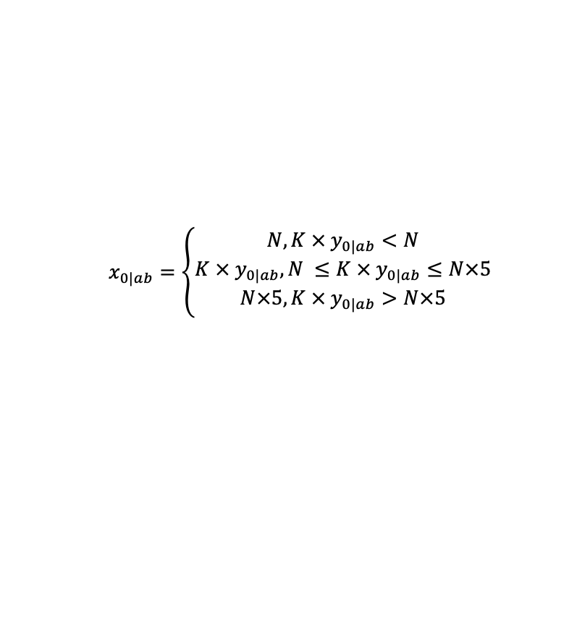
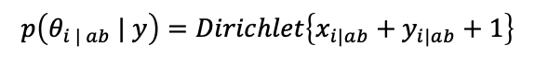
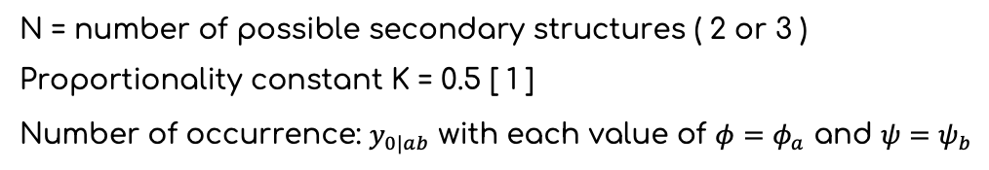
Correction and smoothing
Smoothing
N = number of possible secondary structures ( 2 or 3 )
Proportionality constant K = 0.5 [ 1 ]
Number of occurrence: $y_{0|ab}$ with each value of $φ=φ_{a}$ and $ψ=ψ_{b}$
$$x_{0|ab}=\left\{\begin{aligned}N,K × y_{0|ab}<N \\ K × y_{0|ab}, N ≤K × y_{0|ab}≤N×5 \\ N×5,K × y_{0|ab}>N×5\end{aligned}\right.$$
The two-dimensional posterior estimation is based on the Dirichlet distribution at each value of $φ=φ_{a}$ and $ψ=ψ_{b}$
$$p\left(θ_{i | ab} | y\right)=Dirichlet\left\{x_{i|ab}+y_{i|ab}+1\right\}$$
[ 1 ] Dunbrack Jr, Roland L., and Fred E. Cohen. "Bayesian statistical analysis of protein side‐chain rotamer preferences." Protein Science 6.8 (1997): 1661-1681.
Notes:
K is a scale factorthat affects the influence of the prior distribution
on the posterior distribution by setting the value of x0 in Equation 12 proportional to the number of side chains yo in the exper- imental data with r l = i.

Slide 13
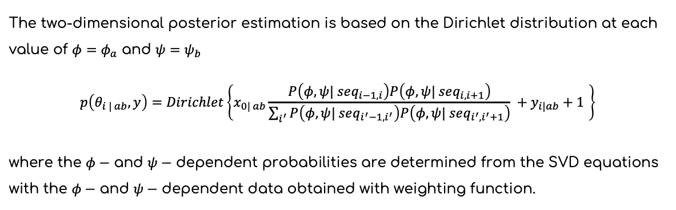
Correction and smoothing
Distribution
The two-dimensional posterior estimation is based on the Dirichlet distribution at each value of $φ=φ_{a}$ and $ψ=ψ_{b}$
$$p\left(θ_{i | ab}, y\right)=Dirichlet\left\{x_{0| ab}\frac{P\left(φ, ψ| seq_{i−1, i}\right)P\left(φ, ψ| seq_{i, i+1}\right)}{\sum_{i^{′}}{P\left(φ, ψ| seq_{i^{′}−1, i^{′}}\right)P\left(φ, ψ| seq_{i^{′}, i^{′}+1}\right)}} +y_{i|ab}+1 \right\}$$
where the $φ−$ and $ψ−$ dependent probabilities are determined from the SVD equations with the $φ−$ and $ψ−$ dependent data obtained with weighting function.
[ 1 ] Dunbrack Jr, Roland L., and Fred E. Cohen. "Bayesian statistical analysis of protein side‐chain rotamer preferences." Protein Science 6.8 (1997): 1661-1681.

Slide 14
Results
Data Set
Old and updated potentials

Slide 15
Data Set
Test Set
4, 392 protein structures
380, 909 three amino acid (triplet) sequences

Slide 16
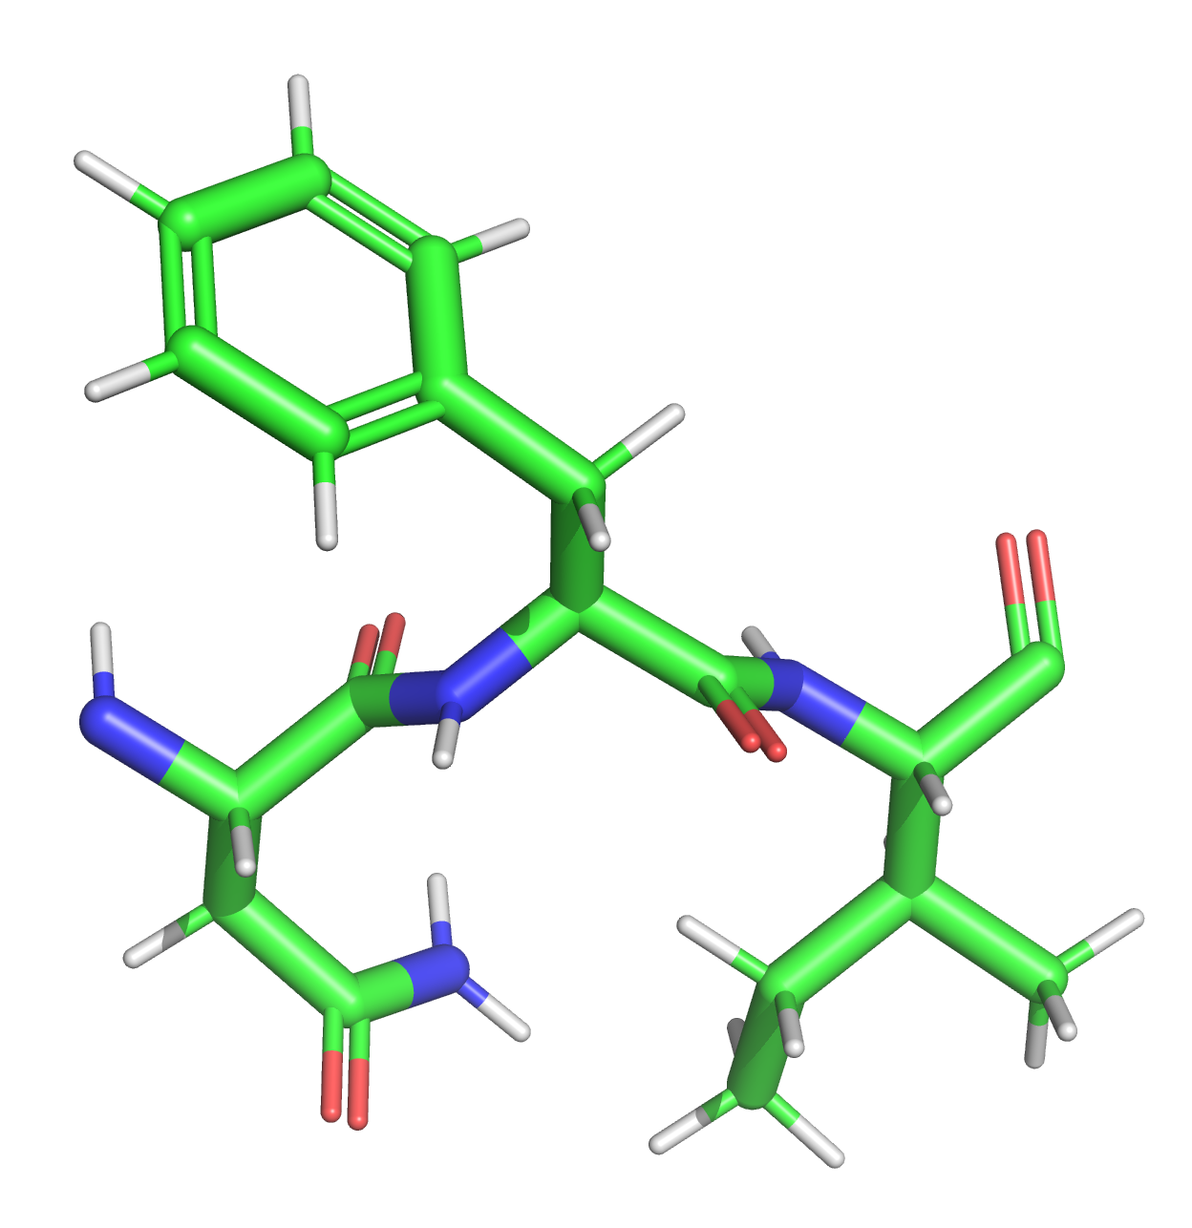
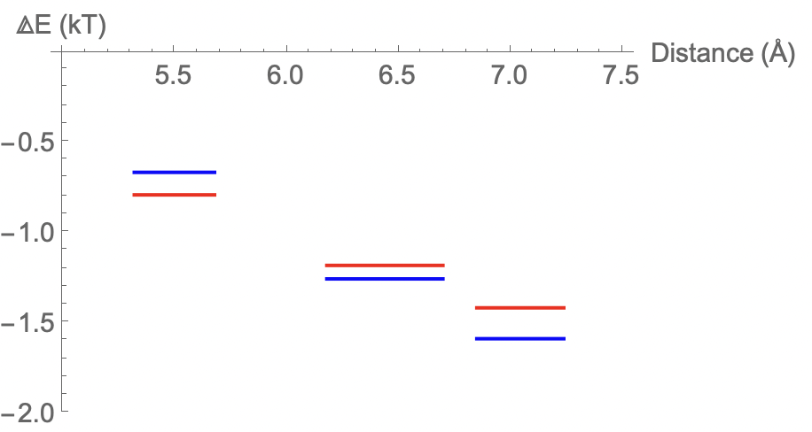
Old and updated potentials
Example of 1 (out of 8000) triplet sequence (N, F, I)
F
Old and updated potential functions
I
N

Slide 17
Summary
We used Bayesian statistics to generate the semi-empirical potential function for enhanced protein secondary structure prediction with high-quality experimentally determined protein structures.
Future Plan
We currently only included protein structures obtained with X-ray diffraction. In the future the structures measured with cryogenic electron microscopy (cryo-EM) will also be included.
The potential functions applicable in our future research needs further tweaking and benchmarking.

Slide 18
Thank you!

